Slide 1
Computing Drives Our World
Exploring Engineering Day 2015

Slide 2
Computers do everything!
Desktops, laptops, tablets
Smartphones
Cars
Websites & the internet
Washing machines

Slide 3
Hardware
“Hardware” – Anything you can touch
Computers
Mice, keyboards, …
Cars
Wheels, dashboards, …
Phones
Touchscreens, buttons, …

Slide 4
Software
“Software” – Telling hardware what to do
Computers
Logging on, using the internet, …
Cars
Radio, air conditioning, …
Phones
Sending texts, playing games, …

Slide 5
Programmer
Programmers are people who write software. You can get a job programming!

Slide 6
Optimization
“Optimization” – Making something work well without working too hard
Good engineers and programmers always optimize!
Engineers & cars
Better gas mileage
Programmers & computers
Working faster
Weighing less

Slide 7
Time for a game...
http://bit.ly/CSEED15

Slide 8
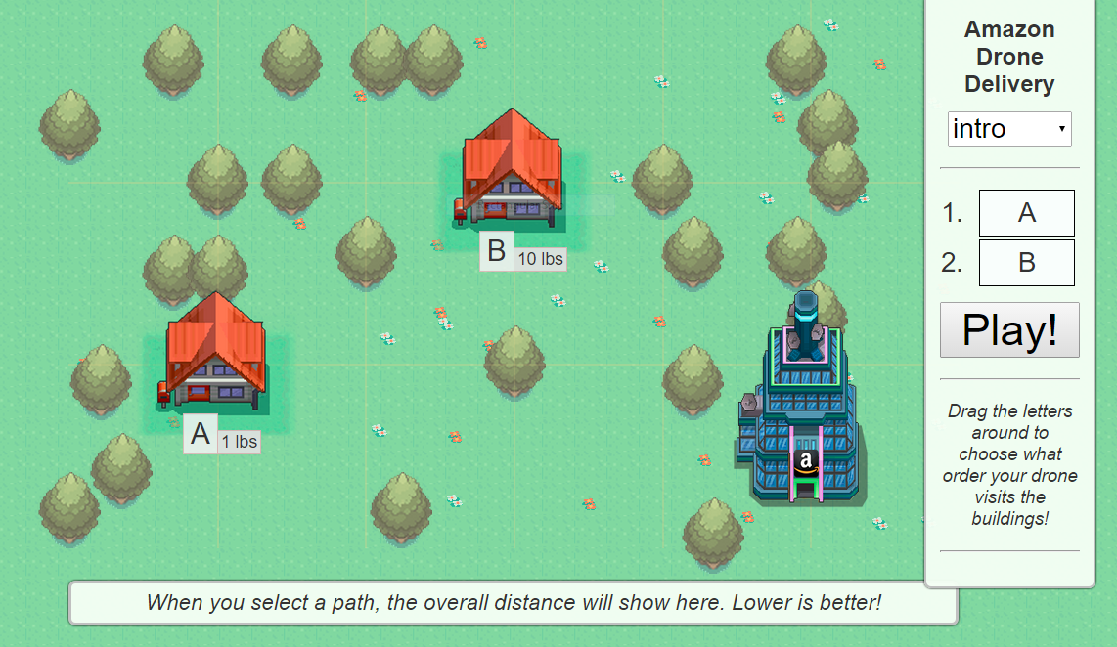
We’re all programmers now! (sort of)
Amazon is starting to use drones to deliver goods to houses, and we want to use the least amount of energy!
Deliver heavy goods first, so they don’t weigh the drone down
Drag the letters on the right of the page to choose what order your drone visits buildings
Once you finish the “intro” mode, go to “medium”, “difficult”, etc.

